Slide 1

Module-II
Problem Solving

Slide 2
Contents
Problem Solving Agent
- Architecture of Problem-Solving Agent
- Formulating Problems, and Example Problems.
Searching Techniques
- Uninformed Search Methods
- Informed Search Methods
Optimization Problems
- Hill climbing search
- Simulated annealing
- Genetic algorithm

Slide 3
Problem-solving agents:
A problem-solving refers to a state where we wish to reach to a definite goal from a present state or condition.
According to computer science, a problem-solving is a part of artificial intelligence which encompasses a number of techniques such as algorithms, heuristics to solve a problem.
The Problem-solving agent is a goal-driven agent and focuses on satisfying the goal.

Slide 4
Steps performed by Problem-solving agent
Goal Formulation: It organizes the steps/sequence required to formulate one goal out of multiple goals as well as actions to achieve that goal.
It is based on the current situation and the agent’s performance measure.
Problem Formulation: It decides what actions should be taken to achieve the formulated goal. There are following five components involved in problem formulation:
{next slide…….}

Slide 5
Problem Formulation
Components involved in problem formulation:
Initial State: It is the starting state or initial step of the agent towards its goal.
Actions: It is the description of the possible actions available to the agent.
Transition Model: It describes what each action does.
Goal Test: It determines if the given state is a goal state.
Path cost: It assigns a numeric cost to each path that follows the goal. An optimal solution has the lowest path cost among all the solutions.

Slide 6
Steps…
Search: It identifies all the best possible sequence of actions to reach the goal state from the current state. It takes a problem as an input and returns solution as its output.
Solution: It finds the best algorithm out of various algorithms, which may be proven as the best optimal solution.
Execution: It executes the best optimal solution from the searching algorithms to reach the goal state from the current state.

Slide 7
Example Problems
Basically, there are two types of problem approaches:
Toy Problem
Example:
Water Jug Problem
8-Puzzel Problem
8-Queen Problem
Tic-Tac-Toe
Real-world Problem
Example:
Traveling sales man Problem (TSP)
VLSI Layout problem
Scheduling the tasks for group of people

Slide 8
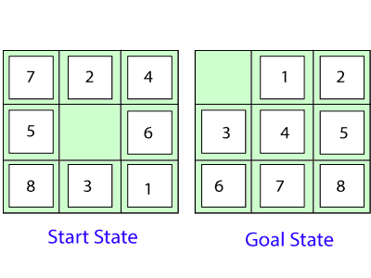
Problem formulation
8 Puzzle Problem: The task is to convert the current state into goal state by sliding
digits into the blank space
The problem formulation is as follows:
States: It describes the location of each numbered tiles and the blank tile.
Initial State: We can start from any state as the initial state.
Actions: Here, actions of the blank space is defined, i.e., either left, right, up or down
Transition Model: It returns the resulting state as per the given state and actions.
Goal test: It identifies whether we have reached the correct goal-state.
Path cost: The path cost is the number of steps in the path where the cost of each step is 1.

Slide 9
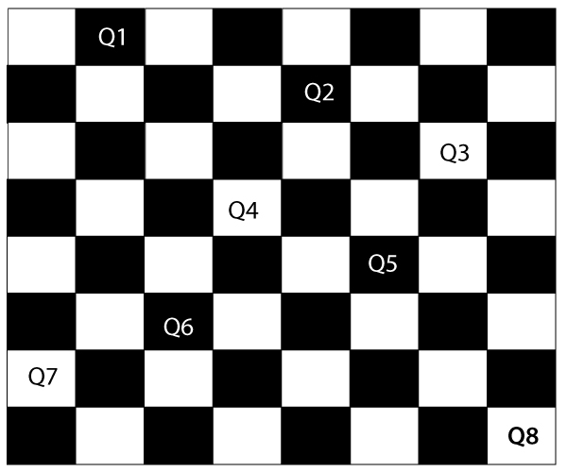
Problem formulation
8-Queens Problem: The aim of this problem is to place eight queens on a
chessboard in an order where no queen may attack another. A queen can attack
other queens either diagonally or in same row and column.
From the following figure, we can understand the problem as well as its correct solution.
For this problem, there are two main kinds of formulation:
Incremental formulation: It starts from an empty state where the operator augments a queen at each step.
Complete-state formulation: It starts with all the 8-queens on the chessboard and moves them around, saving from the attacks.

Slide 10
Problem formulation
1. Incremental formulation: Following steps are involved in this formulation:
States: Arrangement of any 0 to 8 queens on the chessboard.
Initial State: An empty chessboard
Actions: Add a queen to any empty box.
Transition model: Returns the chessboard with the queen added in a box.
Goal test: Checks whether 8-queens are placed on the chessboard without any attack.
Path cost: There is no need for path cost because only final states are counted.
Note: In this formulation, there is approximately 1.8 x 10¹⁴ possible sequence to investigate.

Slide 11
.
2. Complete-state formulation: Following steps are involved in this formulation
States: Arrangement of all the 8 queens one per column with no queen attacking the other queen.
Initial State: The 8 Queens are randomly arranged on the chessboard.
Actions: Move the queen at the location where it is safe from the attacks.
Goal test: Checks whether 8-queens are placed on the chessboard without any attack.
Path cost: There is no need for path cost because only final states are counted.
Note: This formulation is better than the incremental formulation as it reduces the
state space from 1.8 x 10¹⁴ to 2057, and it is easy to find the solutions.

Slide 12
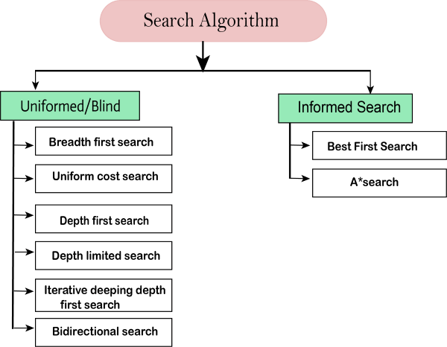
Types of search algorithms
Based on the search problems we can classify the search algorithms into
Uninformed search (Blind search)
informed search (Heuristic search)

Slide 14
Properties:
Following are the four essential properties of search algorithms to
compare the efficiency of these algorithms:
Completeness: A search algorithm is said to be complete if it guarantees to return a solution if at least any solution exists for any random input.
Optimality: If a solution found for an algorithm is guaranteed to be the best solution (lowest path cost) among all other solutions, then such a solution for is said to be an optimal solution.
Time Complexity: Time complexity is a measure of time for an algorithm to complete its task.
Space Complexity: It is the maximum storage space required at any point during the search, as the complexity of the problem.

Slide 15
Uninformed Search Algorithms
Uninformed search is a class of general-purpose search algorithms which operates in brute force-way.
It do not have additional information about state or search space other than how to traverse the tree, so it is also called blind search. (no idea about goal)
Types of Uninformed search algorithms:
Breadth-first Search
Depth-first Search
Depth-limited Search
Iterative deepening depth-first search
Uniform cost search
Bidirectional Search

Slide 16
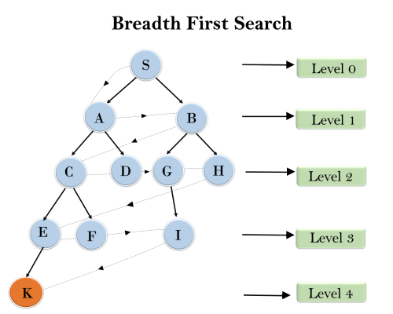
1. Breadth-first Search
In the below tree structure, the traversing of the tree using BFS algorithm from the root node S to goal node K is shown.
S---> A--->B---->C--->D---->G--->H--->E---->F---->I---->K

Slide 17
1. Breadth-first Search
Breadth-first search is the most common search strategy for traversing a tree or graph.
BFS algorithm starts searching from the root node of the tree and expands all successor node at the current level before moving to nodes of next level.
Breadth-first search implemented using FIFO queue data structure.
Advantages:
BFS will provide a solution if any solution exists.
If there are more than one solution for a given problem, then BFS will provide the minimal solution which requires the least number of steps.
Disadvantages:
It requires lots of memory since each level of the tree must be saved into memory to expand the next level.
BFS needs lots of time if the solution is far away from the root node.

Slide 18
Properties of BFS
Time Complexity:
Time Complexity of BFS algorithm can be obtained by the number of nodes traversed in BFS until the shallowest Node. Where the
d= depth of shallowest solution and b is a node at every state.
T(b) = 1+b²+b³+.......+ b^{d}= O(b^{d})
Space Complexity:
Space complexity of BFS algorithm is given by the Memory size of frontier which is O(b^{d})
Completeness:
BFS is complete, which means if the shallowest goal node is at some finite depth, then BFS will find a solution.
Optimality:
BFS is optimal if path cost is a non-decreasing function of the depth of the node.

Slide 19
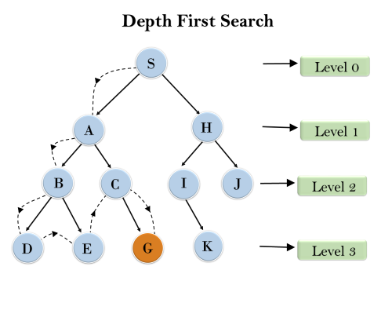
2. Depth-first Search
In the below search tree, we have shown the flow of depth-first search, and it will follow the order as:
Root node → Left node → right node

Slide 20
2. Depth-first Search
Depth-first search is a recursive algorithm for traversing a tree or graph data structure.
It is called the depth-first search because it starts from the root node and follows each path to its greatest depth node before moving to the next path.
DFS uses a stack (LIFO) data structure for its implementation.
Advantage:
DFS requires very less memory
It takes less time to reach to the goal node
Disadvantage:
There is no guarantee of finding the solution.
DFS algorithm goes for deep down searching and may go to the infinite loop.

Slide 21
.Properties of DFS
Completeness: DFS search algorithm is complete within finite state space as it will expand every node within a limited search tree.
Time Complexity: Time complexity of DFS will be equivalent to the node traversed by the algorithm. It is given by:
T(n)= 1+ n²+ n³ +.........+ n^{m}= O(n^{m})
Where, m= maximum depth of any node and this can be much larger than d (Shallowest solution depth)
Space Complexity: DFS algorithm needs to store only single path from the root node, hence space complexity of DFS is equivalent to the size of the fringe set, which is O(bm).
Optimal: DFS search algorithm is non-optimal, as it may generate large number of steps or high cost to reach to the goal node.

Slide 22
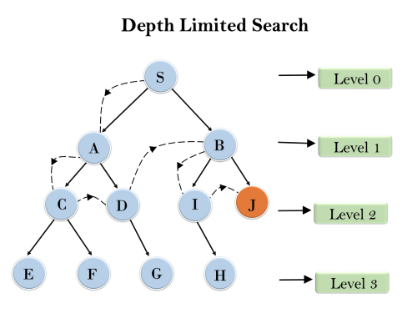
3. Depth-Limited Search
The DLS is the implementation of DFS for the given tree only up to predetermined depth limit.
The original depth of the tree is 3, we can set the limit to the depth for this example it is set as l = 2.
The DFS can be preformed considering the depth of tree as 2

Slide 23
3. Depth-Limited Search
A depth-limited search algorithm is similar to depth-first search with a predetermined limit.
Depth-limited search can be terminated with two Conditions of failure:
Standard failure value: It indicates that problem does not have any solution.
Cutoff failure value: It defines no solution for the problem within a given depth limit.
Advantages:
Depth-limited search is Memory efficient.
Disadvantages:
Depth-limited search also has a disadvantage of incompleteness.
It may not be optimal if the problem has more than one solution.

Slide 24
.Properties of DLS
Completeness: DLS search algorithm is complete if the solution is above the depth-limit (ℓ).
Time Complexity: Time complexity of DLS algorithm is O(b^{ℓ}).
Space Complexity: Space complexity of DLS algorithm is O(b×ℓ).
Optimal: Depth-limited search can be viewed as a special case of DFS, and it is also not optimal even if ℓ>d.

Slide 25
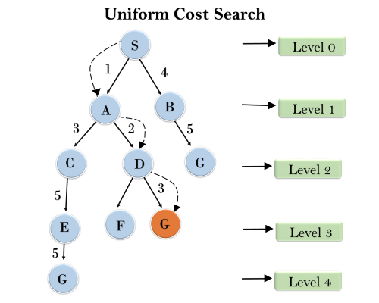
4. Uniform-cost Search Algorithm:
 | S = Initial State and G = Goal State, Start with S
Step1 | SA = 1 and SB = 4, so choose SA and explore A
Step2 | SAC = 4 and SAD = 3, so choose SAD and explore D
Step3 | SADF = 7 and SADG = 6, so choose SADG and Explore G, which is a Goal.
Step4 | Terminates the search and returns Solution Path SADG with cost = 6
Note | Three possible Solutions: SBG with cost = 9 SACEG with cost = 14 SADG with cost = 6

Slide 27
4. Uniform-cost Search Algorithm:
Uniform-cost search is a searching algorithm used for traversing a weighted tree or graph.
The primary goal of the uniform-cost search is to find a path to the goal node which has the lowest cumulative cost.
A uniform-cost search algorithm is implemented by the priority queue. It gives maximum priority to the lowest cumulative cost.
Advantages:
Uniform cost search is optimal because at every state the path with the least cost is chosen.
Disadvantages:
It does not care about the number of steps involve in searching and only concerned about path cost. Due to which this algorithm may be stuck in an infinite loop.

Slide 28
.Properties of UCS
Completeness: Uniform-cost search is complete, such as if there is a solution, UCS will find it.
Time Complexity: Let C* is the Cost of the optimal solution, and ε is each step to get closer to the goal node. Then the number of steps is = (C*/ε)+1. Here we have taken +1, as we start from state 0 and end to C*/ε.
Hence, the worst-case time complexity of Uniform-cost search is O(b^{1 + [C*/ε]}).
Space Complexity: The same logic is for space complexity so, the worst-case space complexity of Uniform-cost search is
O(b^{1 + [C*/ε]}).
Optimal: Uniform-cost search is always optimal as it only selects a path with the lowest path cost.

Slide 29
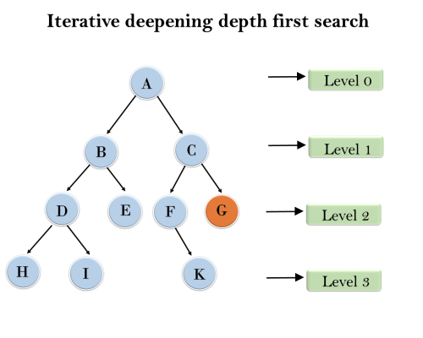
5. Iterative deepening DFS
Following tree structure is showing the iterative deepening depth-first search.
IDDFS algorithm performs various iterations until it does not find the goal
node. At every iteration the Depth limit is incremented by 1.
The iteration performed by the algorithm is given as:
1'st Iteration-----> A {Depth Limit =0}
2'nd Iteration----> A, B, C
{Depth Limit =1}
3'rd Iteration------>A, B, D, E, C, F, G {Depth Limit =2}
4'th Iteration------>A, B, D, H, I, E, C, F, K, G {Depth Limit =3}
In the third iteration, the algorithm will find the goal node and gets terminated.

Slide 31
5. Iterative deepening DFS
The Iterative deepening algorithm is a combination of DFS and BFS algorithms.
This algorithm performs depth-first search up to a certain "depth limit", and it keeps increasing the depth limit after each iteration until the goal node is found.
The iterative search algorithm is useful uninformed search when search space is large, and depth of goal node is unknown.
Advantages:
It combines the benefits of BFS and DFS search algorithm in terms of fast search and memory efficiency.
Disadvantages:
The main drawback of IDDFS is that it repeats all the work of the previous phase.

Slide 32
Properties of IDDFS
Completeness: This algorithm is complete is if the branching factor is finite.
Time Complexity: Let's suppose b is the branching factor and depth is d then the worst-case time complexity is O(b^{d}).
Space Complexity: The space complexity of IDDFS will be O(bd).
Optimal: IDDFS algorithm is optimal if path cost is a non- decreasing function of the depth of the node.

Slide 33
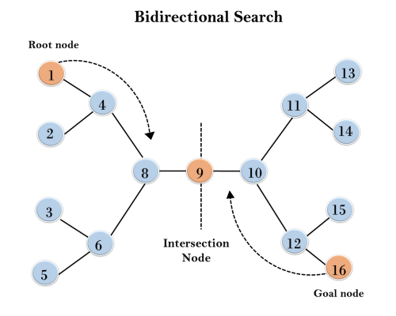
6. Bidirectional Search Algorithm:
This algorithm divides one graph/tree into two sub-graphs. It starts traversing from node 1 in the forward direction and starts from goal node 16 in the backward direction.
The algorithm terminates at node 9 where two searches meet.

Slide 34
6. Bidirectional Search Algorithm:
Bidirectional search algorithm runs two simultaneous searches, one form initial state called as forward-search and other from goal node called as backward-search, to find the goal node.
Bidirectional search can use search techniques such as BFS, DFS, DLS, etc.
Advantages:
Bidirectional search is fast.
Bidirectional search requires less memory
Disadvantages:
Implementation of the bidirectional search tree is difficult.
In bidirectional search, one should know the goal state in advance.

Slide 35
Properties of IDDFS
Completeness: Bidirectional Search is complete if we use BFS in both searches.
Time Complexity: Time complexity of bidirectional search using BFS is O(b^{d}).
Space Complexity: Space complexity of bidirectional search is O(b^{d}).
Optimal: Bidirectional search is Optimal.

Slide 36
Types of search algorithms
Based on the search problems we can classify the search algorithms into
Uninformed search (Blind search)
informed search (Heuristic search)

Slide 37
Informed Search Algorithms
Informed search algorithm contains an array of knowledge such as how far we are from the goal, path cost, how to reach to goal node, etc.
This knowledge help agents to explore less to the search space and find more efficiently the goal node.
The informed search algorithm is more useful for large search space.
Informed search algorithm uses the idea of heuristic, so it is also called Heuristic search.

Slide 38
Heuristics function
Heuristic is a function which is used in Informed Search, and it finds the most promising path.
The heuristic method, however, might not always give the best solution, but it guaranteed to find a good solution in reasonable time.
Heuristic function is represented by h(n), and it calculates the cost of an optimal path between the pair of states.
The value of the heuristic function is always positive.
Admissibility of the heuristic function is given as:
h(n) <= h*(n)
Here h(n) is heuristic cost,
and h*(n) is the estimated cost.

Slide 39
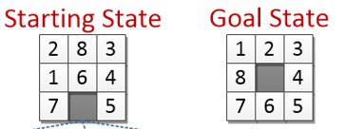
Examples of Heuristics
8 Puzzle Problem: The task is to convert the current state into goal state by sliding digits into the blank space
Heuristic Functions:
Count the no of tiles out of place in a state when it is compared with the
goal state. h(Initial State) = 4 and h(Goal State) = 0
2. Count the no of tiles in a correct place in a state when it is compared with
the goal state. h(Initial State) = 4 and h(Goal State) = 8
Calculate the Manhattan distance for a state, i.e. sum of the distances of
the tiles from their goal position. h(Initial State) = 5 and h(Goal State) = 0

Slide 40
Examples of Heuristics
8-Queens Problem: The aim of this problem is to place eight queens on a chessboard in an order where no queen may attack another.
A queen can attack other queens either diagonally or in same row and column.
Heuristic Function: Count the number of pairs of queens attacking each other, either directly or indirectly.
It means h(goal state) = 0
Here, Pairs attacking are: (Q7,Q4), (Q1,Q5) and (Q4,Q8).
There for h(n) = 3

Slide 41
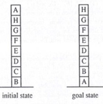
Examples of Heuristics
Block World Problem: In this problem the gaming blocks are need to be arranged as per the goal state
Heuristic function 1: Add 1 point for every block i.e. resting on the thing it is supposed to be resting on. Subtract 1 point for every block that is resting on wrong thing. h(IS) = 4 and h(GS) = 8
Heuristic function 2: For each block that has correct support structure, add 1 point for every block in the support structure. For each block that has incorrect support structure, subtract 1 point for every block in the support structure. h(IS) = -28 and h(GS) = +28

Slide 42
Pure Heuristic Search:
Pure heuristic search expands nodes based on their heuristic value, h(n).
It maintains two lists, OPEN and CLOSED list.
In the CLOSED list, it places those nodes which have already expanded and in the OPEN list, it places nodes which have yet not been expanded (fringe).
On each iteration, each node, n with the lowest heuristic value is expanded and generates all its successors and n is placed to the closed list.
The algorithm continues unit a goal state is found.
In informed search there are two main algorithms:
Best First Search Algorithm(Greedy search)
A* Search Algorithm

Slide 44
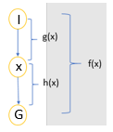
1. Best-first Search Algorithm:
This algorithm always selects the path which appears best at that moment.
It uses the heuristic function and search.
In the best first search algorithm, we expand the node which is closest to the goal node and the closest cost is estimated by heuristic function, i.e.
f(n)= h(n).
where, n is a intermediate node and h(n)= estimated cost from node n to the goal.
The greedy Best first algorithm is implemented
by the priority queue.
I | Initial state
G | Goal state
X | Intermediate state
g(x) | Distance of node X from node I
h(x) | Distance of node G from node X
f(x) | Complete distance from node I to node G through node X

Slide 45
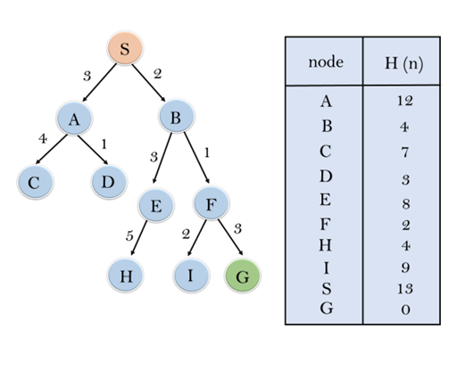
Example on Greedy B-FS
In the following search problem, we will traverse using greedy Best-First Search.
At each iteration, each node is expanded using evaluation function f(n)=h(n), which is given in the below table.

Slide 46
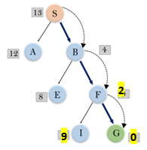
Search…
In this search example, we are using two lists which are OPEN and CLOSED Lists.
Hence the final solution path will be: S → B → F → G
Path cost = 2+1+3 = 6
Node | S | A | B | C | D | E | F | H | I | G
h(n) | 13 | 12 | 4 | 7 | 3 | 8 | 2 | 4 | 9 | 0
Initialization | Expand the nodes of S and put in the CLOSED list
Iteration 1 | Open [A, B], Closed [S]
Iteration 2 | Open [A], Closed [S, B]
Iteration 3 | Open [E, F, A], Closed [S, B] Open [E, A], Closed [S, B, F]
Iteration 4 | Open [I, G, E, A], Closed [S, B, F] Open [I, E, A], Closed [S, B, F, G]

Slide 47
Best first search algorithm:
Step 1: Place the starting node into the OPEN list.
Step 2: If the OPEN list is empty, Stop and return failure otherwise go to
Step 3
Step 3: Remove the node n, from the OPEN list which has the lowest value
of h(n), and places it in the CLOSED list.
Step 4: Expand the node n, and generate the successors of node n.
Step 5: Check each successor of node n, and find whether any node is a
goal node or not. If any successor node is goal node, then return
success and terminate the search, else proceed to Step 6.
Step 6: For each successor node, algorithm checks for evaluation function
f(n), and then check if the node has been in either OPEN or
CLOSED list. If the node has not been in both list, then add it to
the OPEN list.
Step 7: Return to Step 2.

Slide 48
Best First Search
Advantages:
Best first search can switch between BFS and DFS by gaining the advantages of both the algorithms.
This algorithm is more efficient than BFS and DFS algorithms.
Disadvantages:
It can behave as an unguided depth-first search in the worst case scenario.
It can get stuck in a loop as DFS.
This algorithm is not optimal.

Slide 49
Properties..
Time Complexity: The worst-case time complexity of Greedy best first
search is O(b^{m}).
Space Complexity: The worst-case space complexity of Greedy best first
search is O(b^{m}).
Where, m is the maximum depth of the search space.
Complete: Greedy best-first search is also incomplete, even if the given
state space is finite.
Optimal: Greedy best first search algorithm is not optimal.

Slide 50
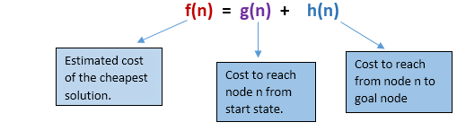
2. A* Search Algorithm:
A* search is the most commonly known form of best-first search.
It uses heuristic function h(n), and cost to reach the node n from the start state g(n).
A* algorithm is similar to UCS except that it uses g(n)+h(n) instead of g(n).
In A* search algorithm, we use search heuristic as well as the cost to reach the node. Hence we can combine both costs , this sum is called as a fitness number.
At each point in the search space, only those node is expanded which have the lowest value of f(n) and the algorithm terminates when the goal node is found.

Slide 51
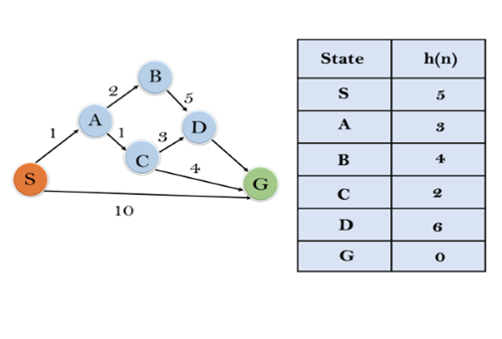
Example on A* search:
In this example, the heuristic value of all states is given in the below table so we will calculate the f(n) of each state using the formula f(n)= g(n) + h(n), where g(n) is the cost to reach any node from start state.
Here again we will use OPEN and CLOSED list.

Slide 52
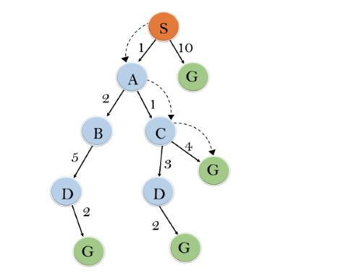
Solution:
State | S | A | B | C | D | G
h(n) | 5 | 3 | 4 | 2 | 6 | 0
Initialization: | {(S, 5)}
Iteration1: | {(S → A, 4), (S → G, 10)}
Iteration2: | {(S → A → C, 4), (S → A → B, 7), (S → G, 10)}
Iteration3: | {(S → A → C → G, 6), (S → A → C → D, 11), (S → A → B, 7), (S → G, 10)}
Iteration4: | Will give the final result, as S → A → C → G It provides the optimal path with cost 6.

Slide 53
Algorithm of A* search:
Step 1: Place the starting node in the OPEN list.
Step 2: Check if the OPEN list is empty or not, if the list is empty then return failure and stop, Otherwise Go to step 3.
Step 3: Select the node from the OPEN list which has the smallest value of evaluation function (g+h), if node n is goal node then return success and stop, otherwise Go to step 4.
Step 4: Expand node n and generate all of its successors, and put n into the CLOSED list. For each successor n', check whether n' is already in the OPEN or CLOSED list, if not then compute evaluation function for n' and place into OPEN list.
Step 5: Else if node n' is already in OPEN and CLOSED, then it should be attached to the back pointer which reflects the lowest g(n') value.
Step 6: Return to Step 2.

Slide 54
A* search:
Advantages:
A* search algorithm is the best algorithm than other search algorithms.
A* search algorithm is optimal and complete.
This algorithm can solve very complex problems.
Disadvantages:
It does not always produce the shortest path as it mostly based on heuristics and approximation.
A* search algorithm has some complexity issues.
The main drawback of A* is memory requirement as it keeps all generated nodes in the memory.

Slide 55
Properties of A*
Complete: A* algorithm is complete as long as:
Branching factor is finite.
Cost at every action is fixed.
Optimal: A* search algorithm is optimal if it follows below two conditions:
Admissible: The first condition Requires for optimality is that h(n) should be an admissible heuristic for A* tree search. An admissible heuristic is optimistic in nature.
Consistency: Second required condition is consistency for only A* graph-search.
If the heuristic function is admissible, then A* tree search will always find the least cost path.
Time Complexity: The time complexity of A* search algorithm depends on heuristic function, and the number of nodes expanded is exponential to the depth of solution d. So the time complexity is O(b^d), where b is the branching factor.
Space Complexity: The space complexity of A* search algorithm is O(b^d)

Slide 56
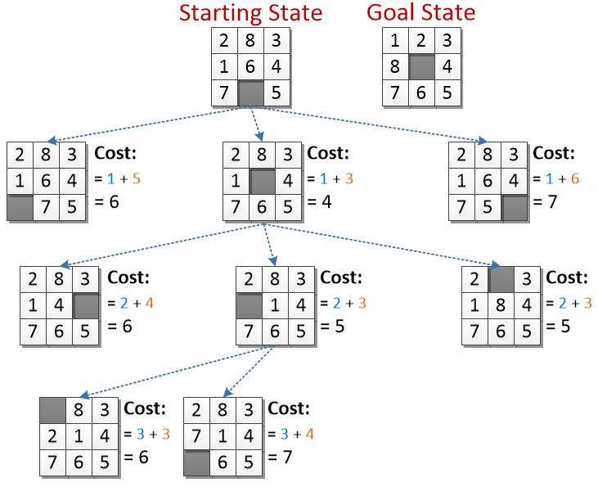
8 puzzle using A*
Level 0
g = 0
Level 1
g = 1
Level 2
g = 2
h(n): count the no of tiles not in place.
Level 3
g = 3

Slide 57
A* example

Slide 58
Hill Climbing Algorithm

Slide 59
Hill Climbing Algorithm
Hill climbing algorithm is a local search algorithm which continuously moves in the direction of increasing elevation/value to find the peak of the mountain or best solution to the problem.
It terminates when it reaches a peak value where no neighbour has a higher value.
It is also called greedy local search as it only looks to its good immediate neighbour state and not beyond that.
State-space Diagram for Hill Climbing:
The state-space landscape is a graphical representation of the hill-climbing algorithm
State-space on the x-axis and objective or cost function on Y-axis.
regions of state space on next slide….

Slide 60
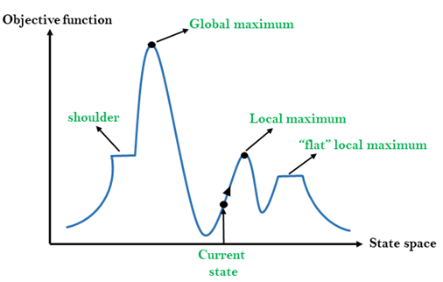
Different regions:
Current state: It is a state in a landscape diagram where an agent is currently present.
Flat local maximum: It is a flat space in the landscape where all the neighbor states of current states have the same value. It is a plateau.
Shoulder: It is a plateau region which has an uphill edge.
Local Maximum: Local maximum is a state which is better than its neighbor states, but there is also another state which is higher than it.
Global Maximum: Global maximum is the best possible state of state space landscape. It has the highest value of objective function.

Slide 61

Types of Hill Climbing Algorithm:
Simple hill Climbing
Steepest-Ascent hill-climbing
Stochastic hill Climbing
1. Simple Hill Climbing:
It only evaluates the neighbour node state at a time and selects the first one which optimizes current cost and set it as a current state.
It only checks it's one successor state, and if it finds better than the current state, then move else be in the same state.
Features:
Less time consuming
Less optimal solution and the solution is not guaranteed

Slide 62
Algorithm:
Step 1: Evaluate the initial state, if it is goal state then return success and Stop.
Step 2: Loop Until a solution is found or there is no new operator left to apply.
Step 3: Select and apply an operator to the current state.
Step 4: Check new state:
If it is goal state, then return success and quit.
Else if it is better than the current state then assign new state as a current state.
Else if not better than the current state, then return to step2.
Step 5: Exit.

Slide 63

Hill climbing:
2. Steepest-Ascent hill climbing:
The steepest-Ascent algorithm is a variation of simple hill climbing algorithm.
This algorithm examines all the successor nodes of the current state and selects one neighbor node which is closest to the goal state.
This algorithm consumes more time as it searches for multiple neighbors

Slide 64
Algorithm for Steepest-Ascent HC:
Step 1: Evaluate the initial state, if it is goal state then return
success and stop, else make current state as initial state.
Step 2: Loop until a solution is found or the current state does
not change.
Let SUCC be a state such that any successor of the current state will be better than it.
For each operator that applies to the current state:
Apply the new operator and generate a new state.
Evaluate the new state.
If it is goal state, then return success and quit, else compare it to the SUCC.
If it is better than SUCC, then set new state as SUCC.
If the SUCC is better than the current state, then set current state to SUCC.
Step 3: Exit.

Slide 65
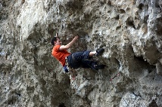
Hill climbing:
3. Stochastic hill climbing:
Stochastic hill climbing does not examine for all its neighbor before moving. Rather, this search algorithm selects one neighbor node at random and decides whether to choose it as a current state or examine another state.

Slide 66
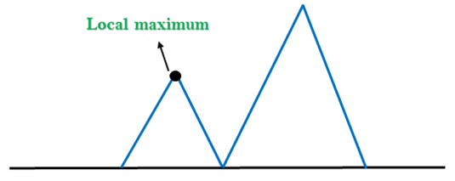
Hill Climbing:
Problems in Hill Climbing:
1. Local Maximum:
A local maximum is a peak state in the landscape which is better than each of its neighboring states, but there is another state also present which is higher than the local maximum.
Solution:
Backtracking technique can be a solution of the local maximum in state space
landscape.

Slide 67
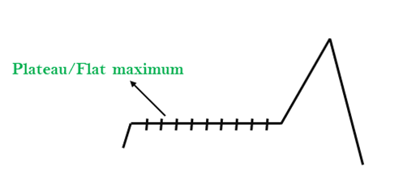
Hill Climbing:
2. Plateau:
A plateau is the flat area of the search space in which all the neighbor states of the current state contains the same value.
Solution: The solution for the plateau is to take big steps or very little steps while searching.

Slide 68
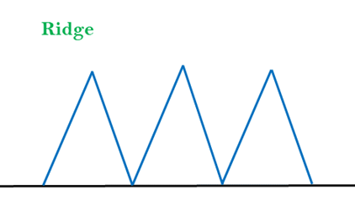
Hill Climbing:
3. Ridges:
A ridge is a special form of the local maximum. It has an area which is higher than its surrounding areas, but itself has a slope, and cannot be reached in a single move.
Solution: With the use of bidirectional search, or by moving in different directions, we can improve this problem.

Slide 69
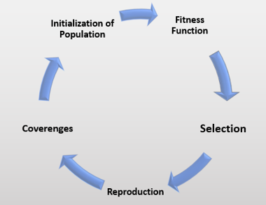
Genetic Algorithm:
A genetic algorithm is a search heuristic that is inspired by Charles Darwin’s theory of natural evolution.
This algorithm reflects the process of natural selection where the fittest individuals are selected for reproduction in order to produce offspring of the next generation.

Slide 70
Notion of Natural Selection
The process of natural selection starts with the selection of fittest individuals from a population.
They produce offspring which inherit the characteristics of the parents and will be added to the next generation.
If parents have better fitness, their offspring will be better than parents and have a better chance at surviving.
This process keeps on iterating and at the end, a generation with the fittest individuals will be found.
This notion can be applied for a search problem.
We consider a set of solutions for a problem and select the set of best ones out of them.

Slide 71
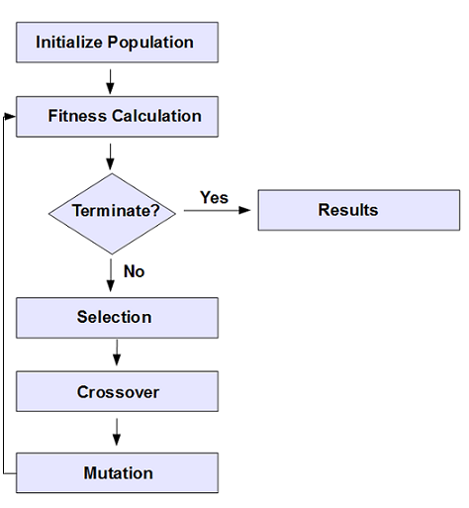
Phases in a genetic algorithm
Initial population
Fitness function
Selection
Crossover
Mutation
Pseudocode:
START Generate the initial population Compute fitness REPEAT 1. Selection 2. Crossover 3. Mutation 4. Compute fitness UNTIL population has converged STOP

Slide 72
Example

Slide 73
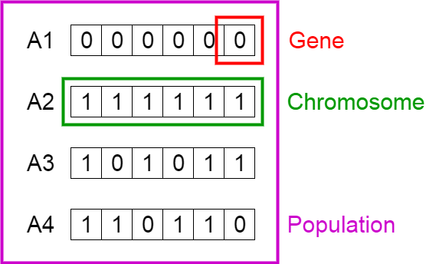
1. Initial Population
The process begins with a set of individuals which is called a Population.
An individual is characterized by a set of parameters (variables) known as Genes. Genes are joined into a string to form a Chromosome (solution).
In a genetic algorithm, the set of genes of an individual is represented using a string. Usually, binary values are used (string of 1s and 0s).
We say that we encode the genes in a chromosome.

Slide 74
2. Fitness Function
The fitness function determines how fit an individual is.
It gives a fitness score to each individual.
Fitness function: Count the number of 1s in an individual
Individual | Fitness score
A1 | 0
A2 | 6
A3 | 4
A4 | 4

Slide 75
3. Selection
The idea of selection phase is to select the fittest individuals and let them pass their genes to the next generation.
Two pairs of individuals (parents) are selected based on their fitness scores.
A1
A2
A1 = 0 and A2 = 6
0 | 0 | 0 | 0 | 0 | 0
1 | 1 | 1 | 1 | 1 | 1

Slide 76
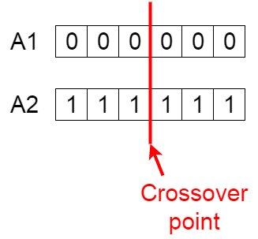
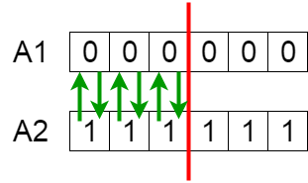
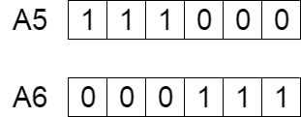
4. Crossover
For each pair of parents to be mated, a crossover point is chosen at random from within the genes.
For example, consider the crossover point to be 3 as shown below.
Offspring are created by exchanging the genes of parents among themselves until the crossover point is reached.
The new offspring are added to the population.

Slide 77
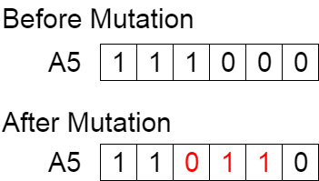
5.Mutation
In certain new offspring formed, some of their genes can be subjected to a mutation with a low random probability. This implies that some of the bits in the bit string can be flipped.
Mutation occurs to maintain diversity within the population and prevent premature convergence.
Termination:
The algorithm terminates if the population has converged. Then it is said that the genetic algorithm has provided a set of solutions to our problem.
Comments:
The population has a fixed size.
The sequence of phases is repeated to produce individuals in each new generation which are better than the previous generation.

Slide 78
Simulated Annealing:
Simulated Annealing is an algorithm which yields both efficiency and completeness.
The algorithm picks a random move, instead of picking the best move.
If the random move improves the state, then it follows the same path.
Otherwise, the algorithm follows the path which has a probability of less than 1 or it moves downhill and chooses another path.

Slide 79
Means-Ends Analysis (MEA):
Means-Ends Analysis is a mixture of Backward and forward search technique.
Means-Ends Analysis is problem-solving techniques used in Artificial intelligence for limiting search in AI programs.
The MEA technique was first introduced in 1961 by Allen Newell, and Herbert A. Simon in their problem-solving computer program, which was named as General Problem Solver (GPS).
The MEA analysis process centered on the evaluation of the difference between the current state and goal state.

Slide 80
How means-ends analysis Works:
The means-ends analysis process can be applied recursively for a problem. It is a strategy to control search in problem-solving.
Following are the Steps describing the working of MEA technique
Evaluate the difference between Initial State and final State.
Select the various operators which can be applied for each difference.
Apply the operator at each difference, which reduces the difference between the current state and goal state.

Slide 81
Algorithm for Means-Ends Analysis:
Step 1: Compare CURRENT to GOAL, if there are no differences between both then return Success and Exit.
Step 2: Else, select the most significant difference and reduce it by doing the following steps until the success or failure occurs.
Select a new operator O which is applicable for the current difference, and if there is no such operator, then signal failure.
Attempt to apply operator O to CURRENT. Make a description of two states. i) O-Start, a state in which O’s preconditions are satisfied. ii) O-Result, the state that would result if O were applied In O-start.
If (First-Part ← MEA (CURRENT, O-START) And (LAST-Part ← MEA (O-Result, GOAL), are successful, then signal Success and return the result of combining FIRST-PART, O, and LAST-PART.

Slide 82
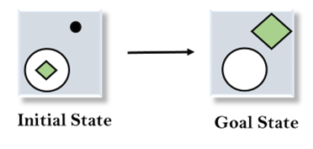
Example of Mean-Ends Analysis:
We have given the initial state and goal state. In this problem, we need to get the goal state by finding differences between the initial state and goal state and applying operators.

Slide 83

Solution
To solve, first find the differences between initial states and goal states, and for each difference, we will generate a new state and will apply the operators. The operators we have for this problem are:
Move
Delete
Expand
1. Evaluating the initial state:
In the first step, we will evaluate the initial state and will compare the initial and Goal state to find the differences between both states.

Slide 84
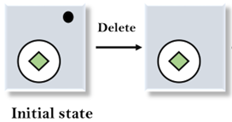
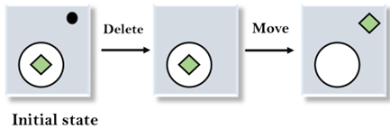
.
Solution
2. Applying Delete operator:
As we can check the first difference is that in goal state there is no dot symbol which is present in the initial state, so, first we will apply the Delete operator to remove this dot.
3. Applying Move Operator:
After applying the Delete operator, the new state occurs which we will again compare with goal state. After comparing these states, there is another difference that is the square is outside the circle, so, we will apply the Move Operator.

Slide 85
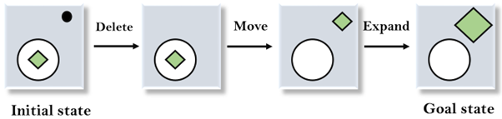
.
Solution
4. Applying Expand Operator:
Now a new state is generated in the third step, and we will compare this state with the goal state. After comparing the states there is still one difference which is the size of the square, so, we will apply Expand operator, and finally, it will generate the goal state.

Slide 86
Simulated Annealing:
The physical analogy: A solid material is heated past its melting point and then cooled back in to a solid state (Annealing).
The final structure is depends on how the cooling is performed.
Algorithm:
First generate random solution.
Calculate the cost using some cost function you have designed.
Generate a random neighboring solution.
Calculate a new solution cost
Compare them:
if Cnew < Cold, then move to the new solution.
if Cnew > Cold, then may be move to new solution.
Repeat step 3-5 until an acceptable solution is found OR you reach some maximum no. of iterations.

